Slide 1
Perfect Connect 4
Michael Henson & Brandon Isaac

Slide 2

Play It Yourself Must be on the eduroam Wi-Fi
http://10.227.20.162:5000
Or scan the QR code (do not use https)
M

Slide 3
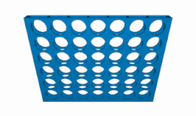
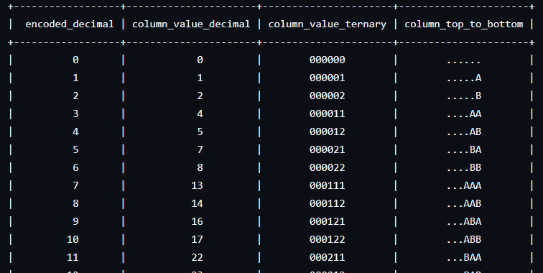
Considered Options
Look-up Table
14 Terabytes of 4.5 trillion states
Internet Lookup
Difficult and Prone to breaking
Reverse Calculation
Starts from winning positions and works backwards
MinMax
Looks at possible future moves and picks best
M

Slide 4
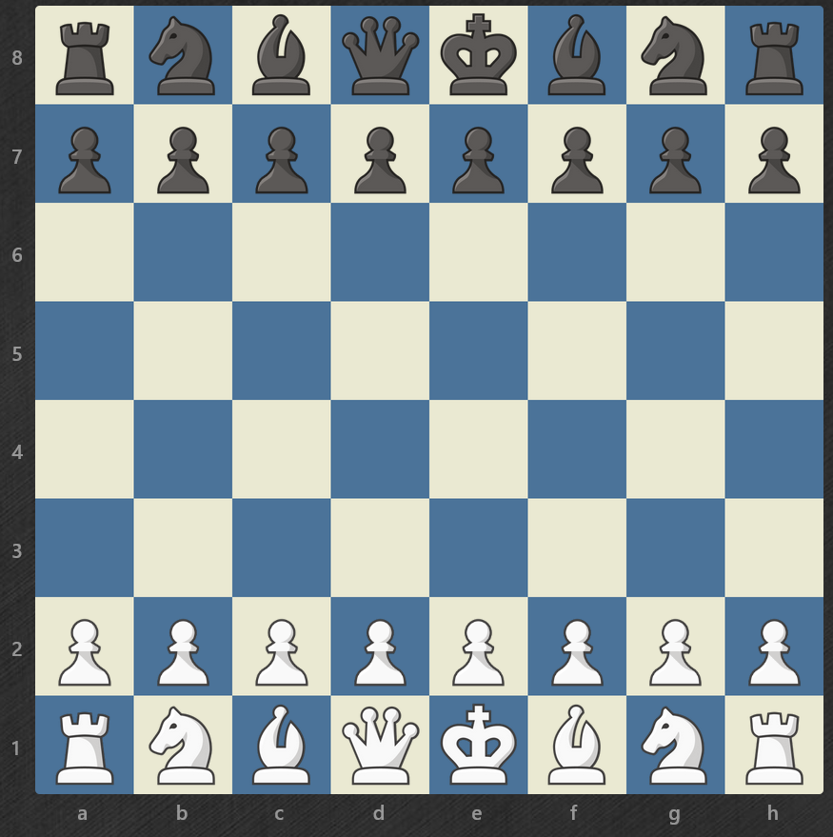
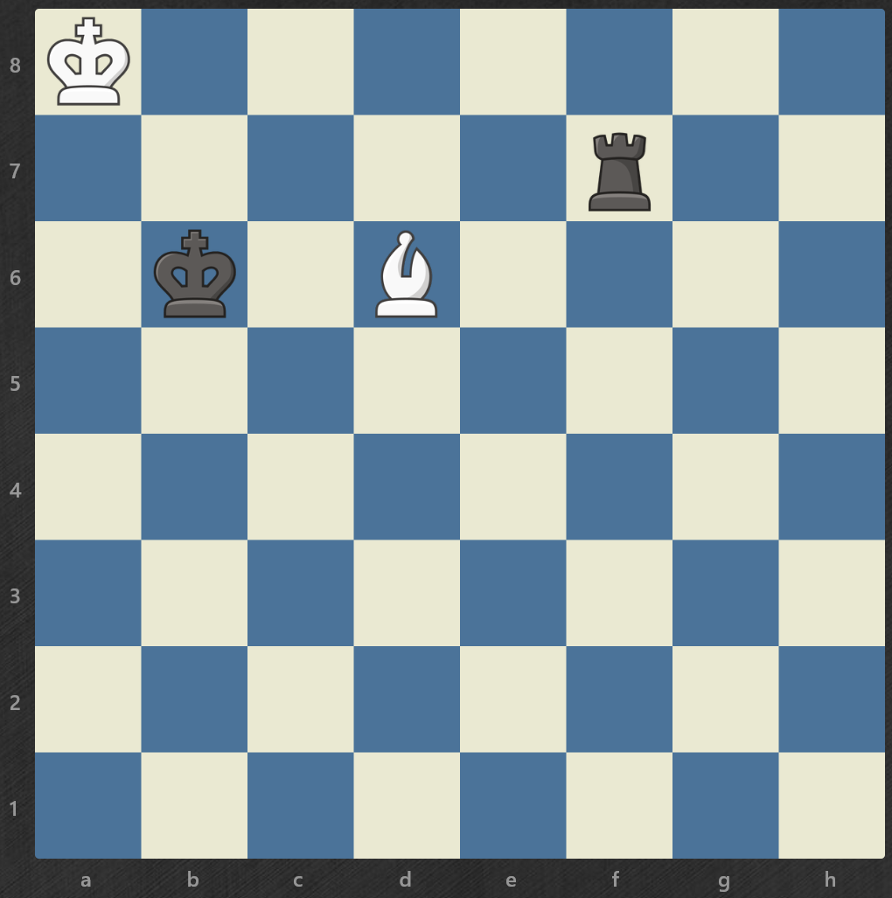
Initial Designs
Initial Position, anyone's game
Hybrid approach:
Depth-first bottom up structure
Width-first top down prebaked positions
Meet in the middle for optimization
Endgame, will draw with perfect play
B

Slide 5
Fundamental flaw
Assumes that the only chips that matter are the ones in the winning row
This assumption cuts down on complexity per move immensely, as there are less than 70 spots for 4 in a row
With <70 end states, you can relatively easily backtrack to previous move states. For turn T-1, there are 70*4= 280 board states. For turn T-3, there are 70*4*7*7=13,720 states, and so on.
This assumption was not implementable with our code
B

Slide 6
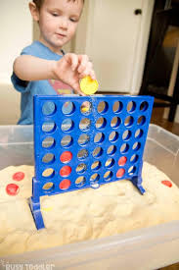
Initial Approach
Bottom-up calculations
Start simple, make legal moves + detect immediate wins
Implement smarter move making until it can beat a perfect CPU
Like teaching a kid to play connect 4 from scratch
Speed it up to play smarter
M

Slide 7
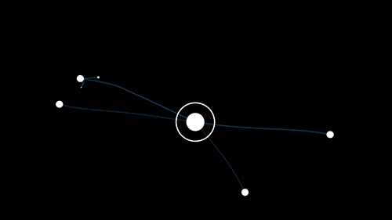
MiniMax
MinMax checks every position that the CPU and player could play.
It scores them base on how close it gets it to winning.
Then MinMax chooses the move that gives it the best score
This does result in exponential growth
So we limit the calculations to a maximum depth
M

Slide 8

Alpha-Beta
Alpha-Beta is a way of speeding up the MinMax algorithm by trimming the obviously bad moves.
If a move puts the CPU in a bad position, it doesn’t need to keep calculating the future moves past that since they will not be used.
B

Slide 9
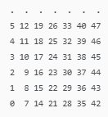
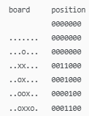
Bitboard
Bitboard is a way to further speed up the MinMax Algorithm by using two integers to store the board position.
Using integers instead of 2D arrays speed up calculations and calculating winning moves
One integer stores the player tokens while the other stores the CPU tokens.
Faster win detection using bit shifts instead of checking every position
Player Integer
M

Slide 10
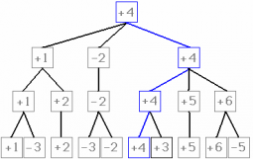
Transposition Table
Stores and reuses previously calculated results in memory.
Reduces calculation time by checking memory first before recalculating moves
Works like computer cheche
B

Slide 11
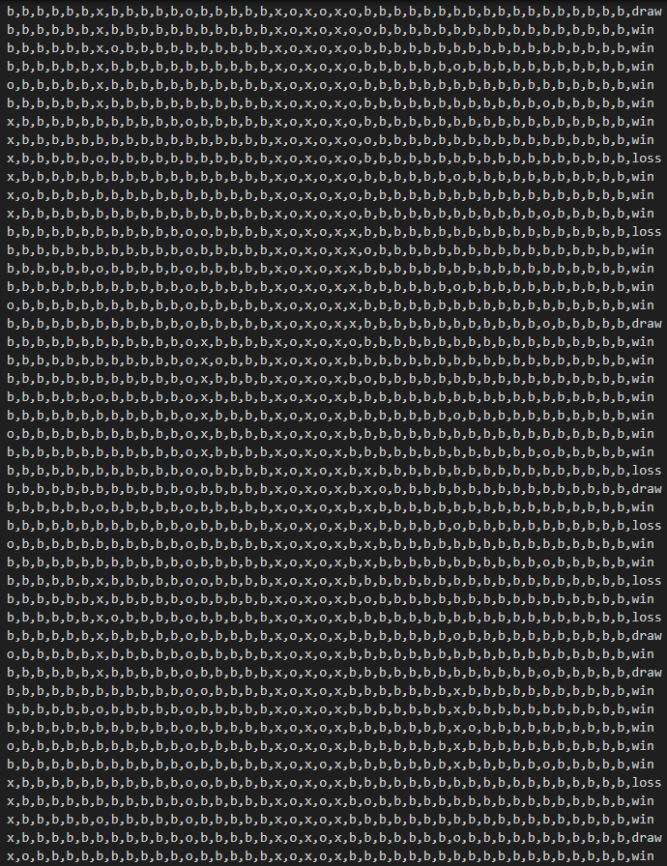
Opening Book
The opening book has all the valid game states for turn 8 recorded for quick look up.
These states are organized by winning/ tied/ loosing states.
The algorithm will work to hit one of the winning states by turn 8
This reduces the chance of bad decision in the early game
M

Slide 12
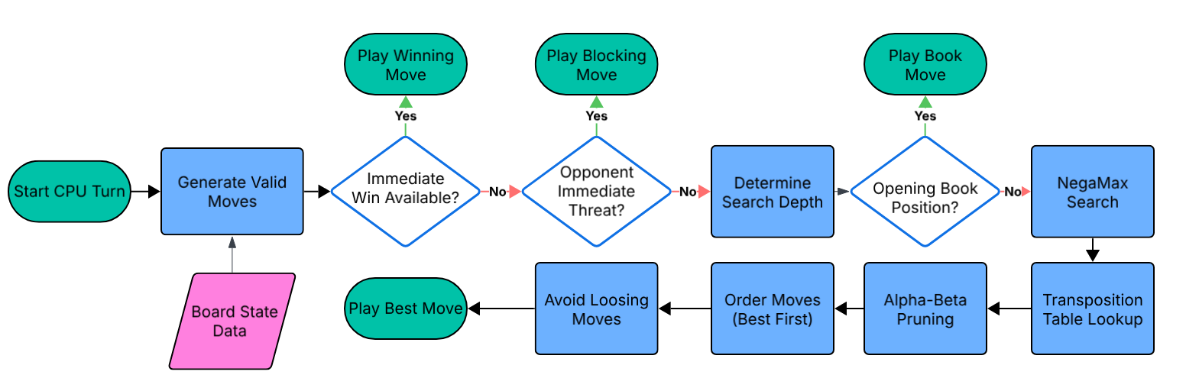
B

Slide 13
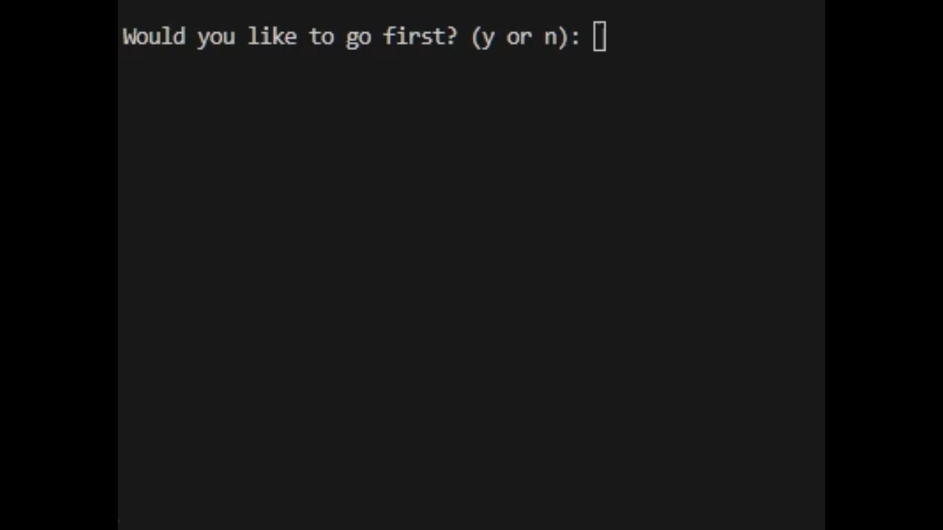
Demo video
B

